Slide 1
Data Science Jobs Market
United States, Canada, United Kingdom, Australia
Presenters: May Ang, Kelvin Deng, Yijing Su, Thao Hoang
Date: Feb 18, 2021
Notes:
Su

Slide 2
Agenda
Project motivation
ETL process
Dashboard creation process
Results
Summary of insights
Future works
Q&A
Github Link to the ETL process and the final cleaned data set: angmay/DataJobMarket (github.com)
Github Link to Dashboard creation process and the final report: Navyhoang/Project2-DataJobs-App (github.com)

Slide 3
Project motivation
1
What questions do we answer?
Notes:
Su

Slide 4
Project Motivation
Data are becoming the new raw material of business." – BY CRAIG MUNDIE, SENIOR ADVISOR TO THE CEO AT MICROSOFT
Notes:
Summarize the intro

Slide 5
ETL Process
2
Data extraction
Data tranformation
Data loading and storage
Notes:
May

Slide 6
Assumptions
Data roles were scraped from Indeed on 15 December 2020
Job titles were categorized for simplification purpose

Slide 7

Extraction
Job postings from Indeed (Web Scrape)
Indeed.ca
Indeed.com
Indeed.sg
Indeed.au
Health and wellness surveys (csv)
Kaggle
Latitude and Longitude (API)
api.opencagedata.com

Slide 8
Transformation
Data inconsistencies
Indeed job postings (location)
Survey responses (gender, typos)
Foreign Keys
Country code
Job type code

Slide 9
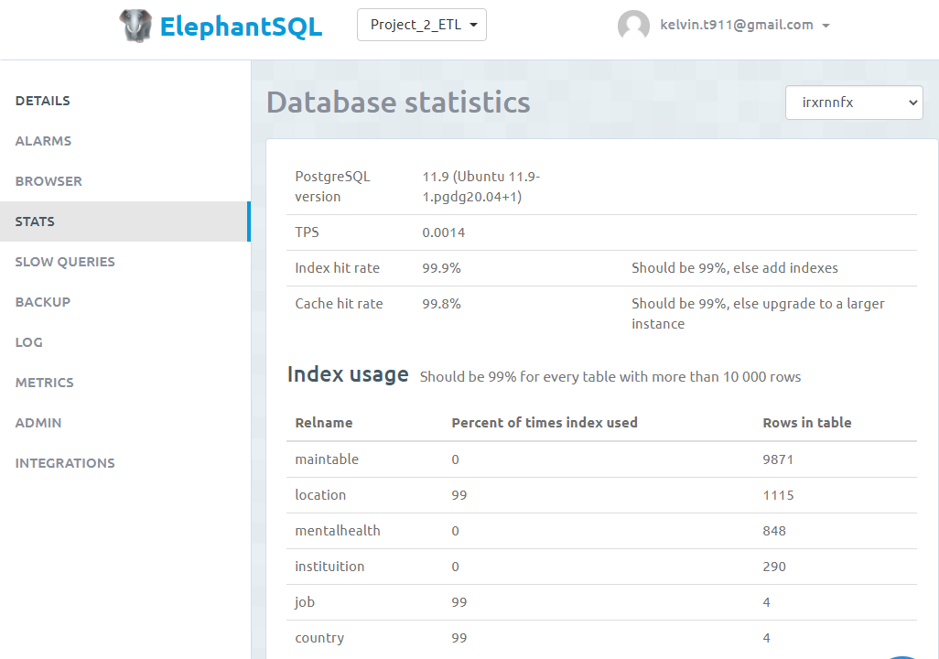

Load
Relational database: Elephant SQL
ERD

Slide 10
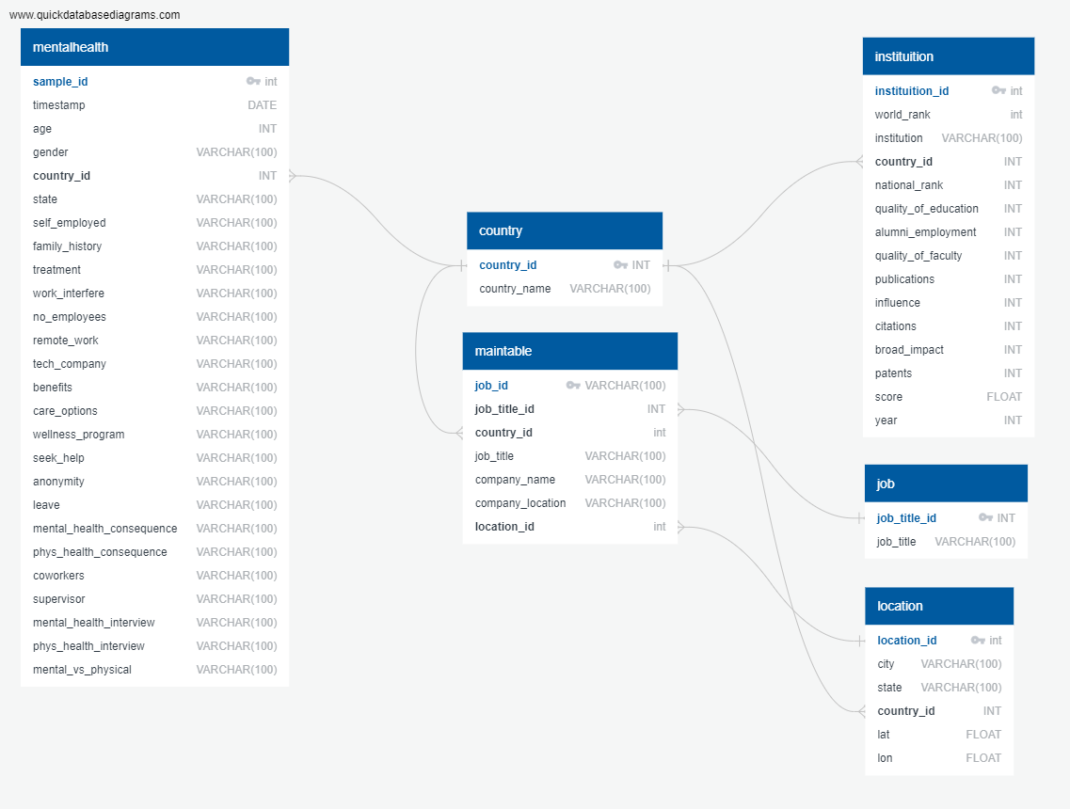
The loaded database
Four relational tables in the SQL Elephant Database
Each with unique key for merging purposing during querying process

Slide 11
Dashboard Creation Process
3
Data querying from database
Charts creation
Dashboard presentations
Notes:
Kelvin

Slide 12





Apps Structure
Flask
SQL Alchemy
Used to render html and API routes
Query data from database and present them as APIs
Html & Heroku
Java Script
Used Bootstrap template for the dashboard
Reference all JS files and necessary dependencies
Heroku to host our dashboard
JS libraries used to create charts:
Plotly
D3
Leaflet
WordCloud (not covered in class)
Notes:
<a href='https://www.freepik.com/photos/technology'>Technology photo created by kjpargeter - www.freepik.com</a>

Slide 13
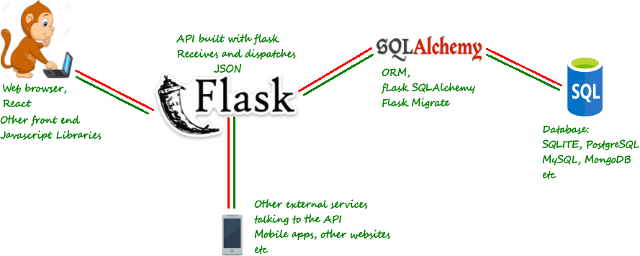
Dashboard Design
Flask by example 5 (How to build a simple REST API) (danidee10.github.io)

Slide 14
Results
4
Notes:
Kelvin

Slide 15
App Launching
Data Job Dashboard (datajobapp.herokuapp.com)

Slide 16
Summary of Insights
5
Answers to our questions.
Notes:
Navy

Slide 17

9,871
254
1,115
Total Job Postings
Remote Jobs
Cities

Slide 18
Summary
CA focused results
Many data jobs are in ON, followed by BC
In ON: majority of jobs are in and surrounding Toronto
Data Analyst >> Data Engineer >> Data Scientist >> Machine Learning
In BC: majority of jobs are in Vancouver
Data Engineer >> Data Analyst >> Data Scientist >> Machine Learning
Most survey responders reported either “Don’t know” or “Somewhat easy” to take leaves
20% have wellness program at work
40% have work benefits

Slide 19
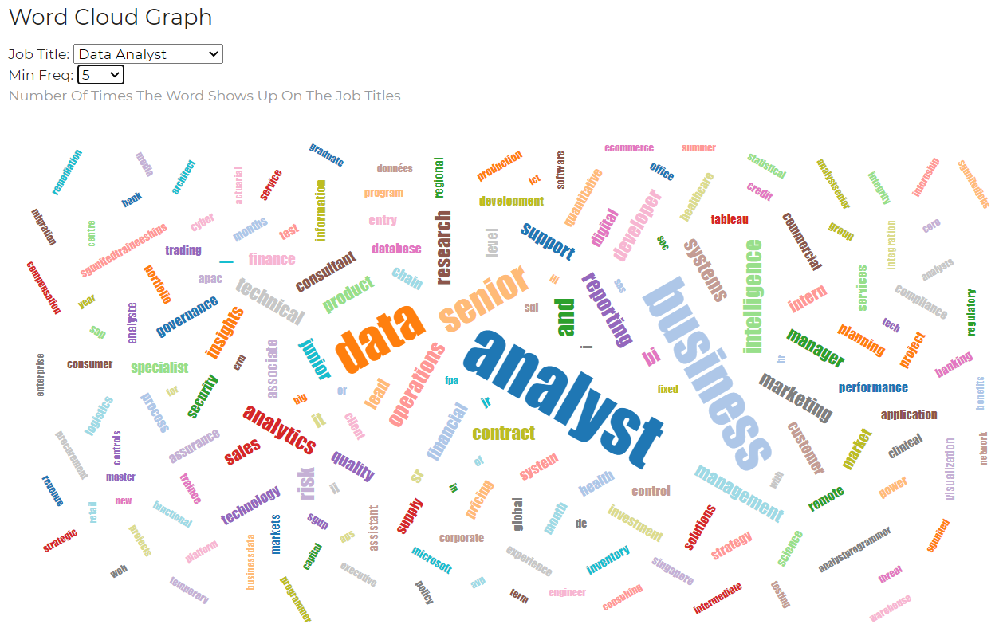
Notes:
May

Slide 20
Future Work
6
Notes:
Su

Slide 21
Future Work
Tablet and Mobile App
Deploy the app for different screen sizes
Real-time Update
Update dashboard with latest job postings
More user interactions
Add more features to improve users experience
Include more countries
Expand database to include job postings and surveys from more countries
Trend Predictions
Predict data job demand using Linear Regression
Job Classification
Classify job postings based on key words using natural language processing

Slide 22
THANKS!
Any questions?

Slide 23
References

